Slide 1

Transition to
Year 1/2

Slide 2
Happy, Healthy, High Achieving
Our School Vision and Values
Our school values are at the core of everything we do. They underpin our teaching and learning and provide an environment which prepares our pupils as confident, happy citizens.
‘Happy, Healthy, High Achieving’
Our School Vision:
Here at Brownlow Primary School, we nurture our children to produce exceptional outcomes through developing their independence, curiosity and creativity. We want our children to be respectful, resilient and responsible young people who understand what it means to belong and have a positive impact on their community and the wider world.
We aim to be a school where:
Everyone is ‘Happy’ being in our supportive, inclusive and nurturing environment, allowing them to develop a love of learning that will impact the rest of their lives.
Everyone is ‘Healthy’ physically and emotionally as part of a valued community, which offers a diverse experience of opportunities.
Everyone is ‘High Achieving’, encouraged and motivated to reach their full potential, immersed in an inspiring curriculum.

Slide 3
Happy, Healthy, High Achieving
Our ‘Super 6’ values
Our ‘Super 6’ Superheroes represent our values:
Captain Courage – making good choices in the face of challenge
Ruby Respect – respect yourself, other people and the environment
Independence Ishmael – be ready to learn
Robin Responsibility – take ownership and think of others
Resilience Ravi – keep going and stay positive
Eden Equality - everyone different, everyone belongs

Slide 4

Does everything change now my child is in Year 1/2?
Our aim is to ensure that the children experience a smooth transition from EYFS and Year One to their mixed Year One and Two class. Children will have access to continuous provision as they transition and move towards more formal learning.
We will continue to have daily Phonics or Spelling, English and Maths sessions and then also incorporate the other areas of learning across the National Curriculum into our week. Termly information will be sent home on BROMCOM/MCAS app about our upcoming topics.

Slide 5
Year 1/2 Teaching Staff:
Teacher Name | Class Name
Mr J Cockerill | 1/2C
Mrs H Ray | 1/2 R
Mrs N Wade | 1/2W
Mr G Rhodes | 1/2GR
Mrs J Challis | 1/2JC

Slide 6

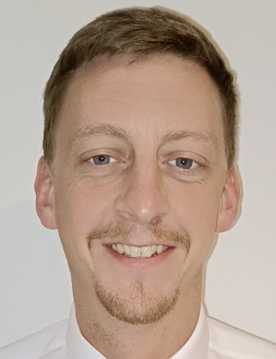
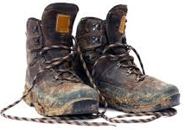

I am your new teacher -
my name is:
Mr Cockerill
Our Class name is: 1/2C
INSERT PHOTO
All About Me
I am looking forward to getting to know you, your hobbies, learning about your hopes and dreams, and helping you at school. What do you enjoy learning about?
I like to explore the outdoors in all weathers and I love jumping in puddles! I like spending time with my friends and family playing boardgames and completing puzzles.
My mystery item is….
My walking boots.
They take me everywhere!!
I hope you all have a fantastic summer and look forward to welcoming you to our class.

Slide 7
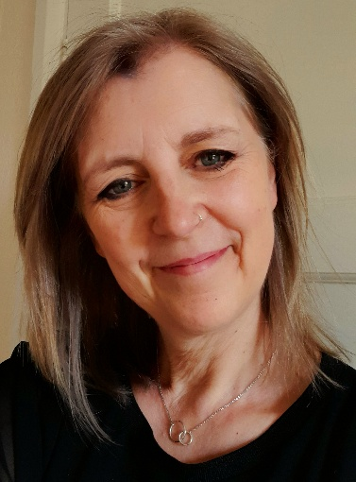

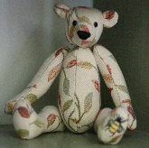



I am your new teacher -
my name is:
Mrs Ray
Our Class name is: 1/2R
INSERT PHOTO
All about me:
I am looking forward to getting to know you, learning about your hopes and dreams, and helping you at school.
I love to work on my sewing machine, creating things for my home and for my friends. I spend lots of time in my garden, watching the seasons come and go, listening to birds singing and spotting secret visitors; badgers and muntjacs! I love to get lost in books where I can meet new characters and visit far away places.
My mystery item is… My teddy bear.
I made him with love and care.
I hope you all have a fantastic summer and look forward to welcoming you to our class.

Slide 8
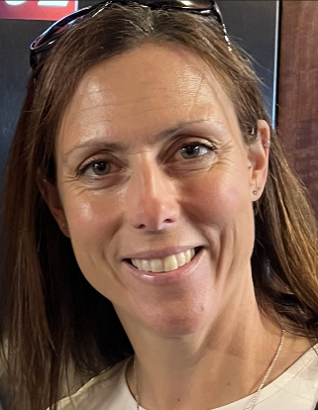
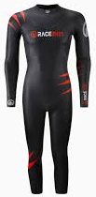
I am your new teacher -
my name is:
Mrs Wade
Our Class name is: 1/2W
INSERT PHOTO
All About Me
I am looking forward to getting to know you, your hobbies, learning about your hopes and dreams and helping you at school.
I like spending time with my friends and family, reading books, running and taking my two dogs for long walks in the countryside. I love to visit the beach, collect seashells and go swimming in the sea, even in the winter…brrrrr!
My mystery item is…
My wetsuit! It keeps me warm
in the cold sea!
I hope you all have a fantastic summer and look forward to welcoming you to our class.

Slide 9
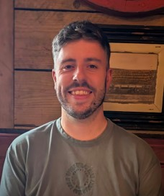

I am your new teacher -
my name is:
Mr Rhodes
Our Class name is: 1/2GR
All About Me
I am very excited to get to know you and help you at school. We are going to have a year full of fun, whilst learning lots of new skills. I love reading and can not wait to share some of my favourite stories with you and listen to you read.
My favourite subject at school was Maths and I can not wait to discover yours! I love running, from parkruns to marathons and I volunteer at the junior parkrun in the town park. I hope to see some of you there!
My mystery item is….
My F1 Cap. I love racing.
I hope you all have a fantastic summer and look forward to welcoming you to our class.

Slide 10
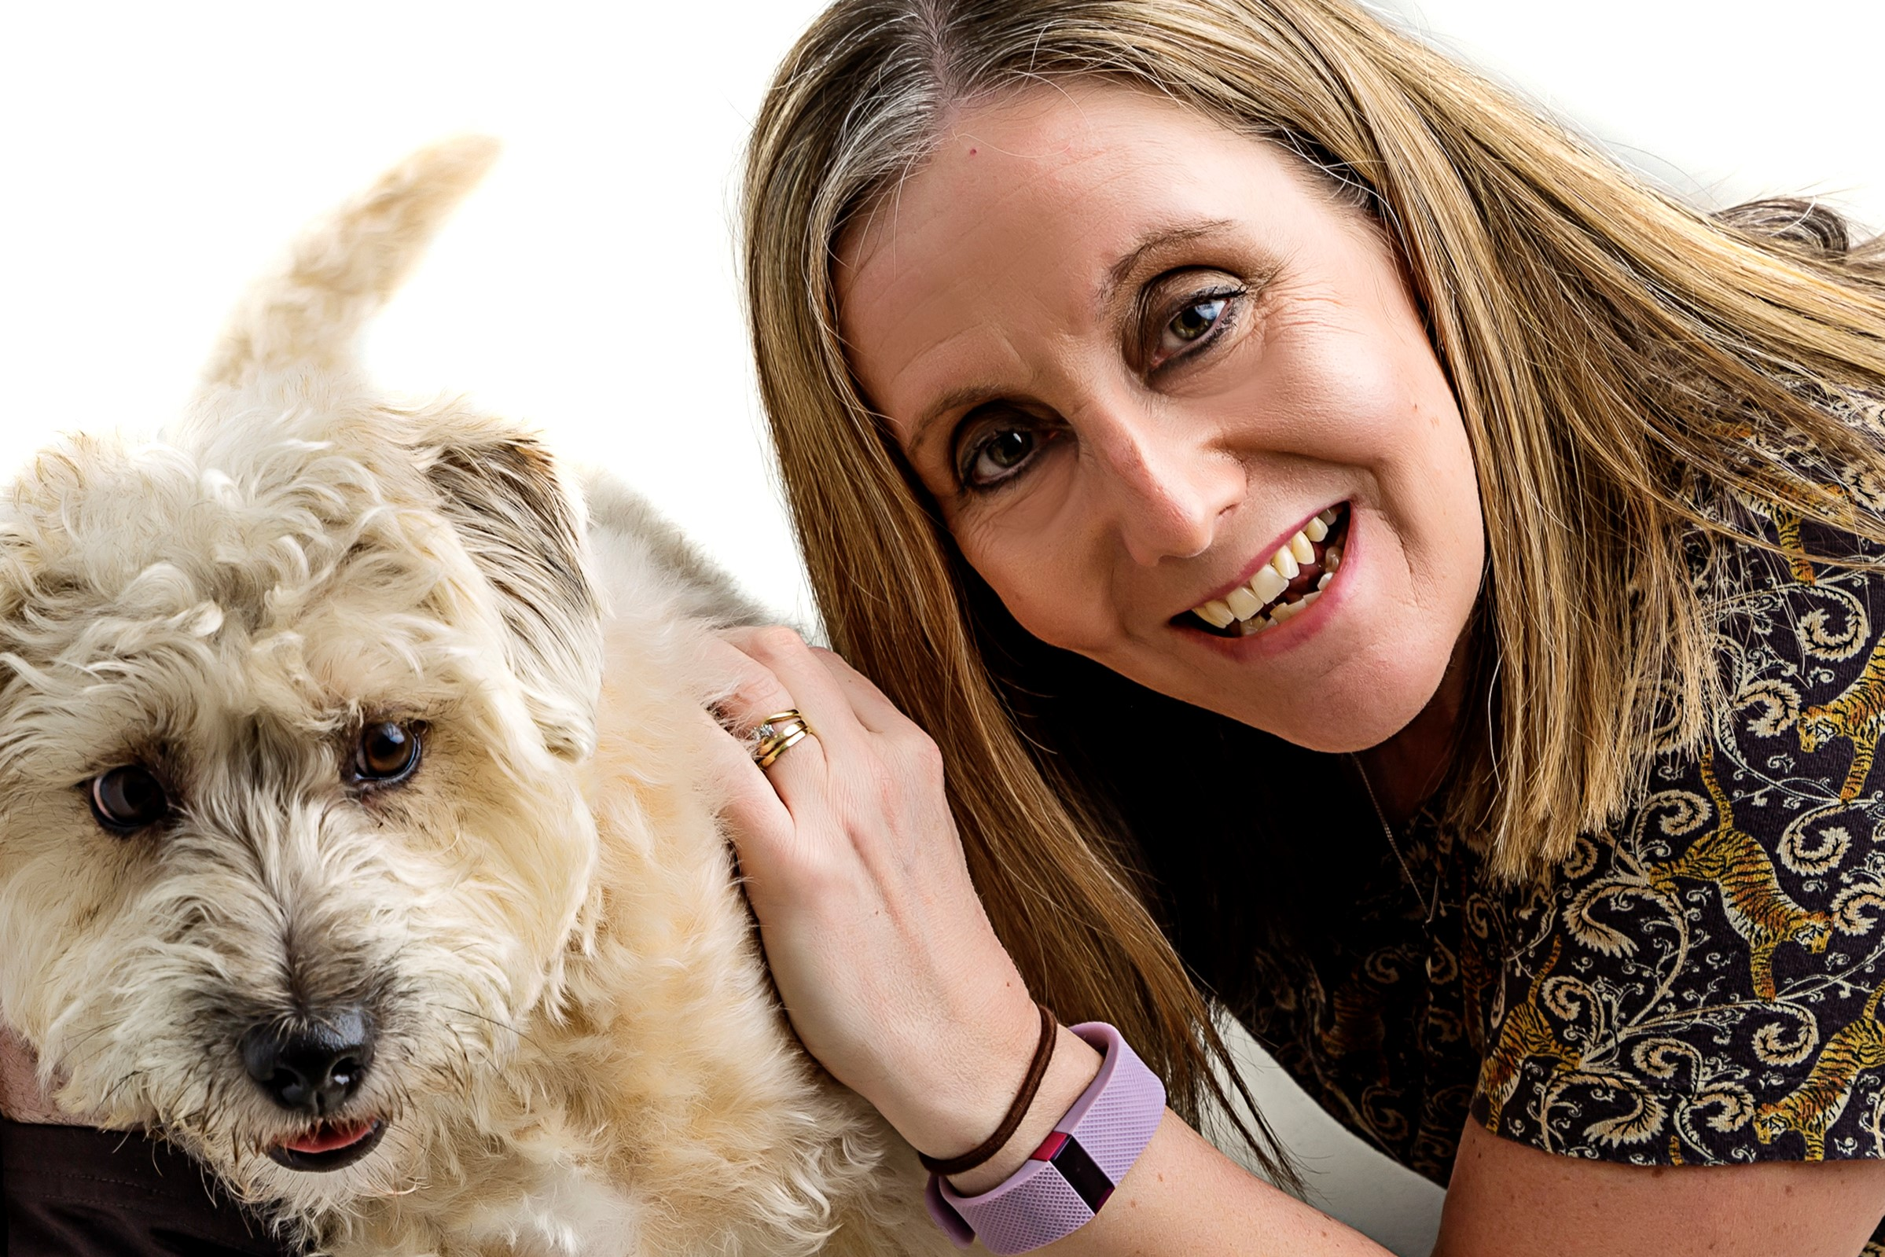
I am your new teacher -
my name is:
Mrs Challis
Our Class name is: 1/2JC
INSERT PHOTO
All About Me
I enjoy reading, going to the beach, spending time with my family and seeing my friends. I am married to Mr Challis, and I have 2 sons called Dan and Ben. I also have a dog called Alice and a cat called Fliss.
I am looking forward to getting to know all about you, your hobbies, your hopes and dreams. I am both proud and excited to be going on your Brownlow learning journey with you.
My mystery item is….
My Kindle!! It opens a whole new
world of experiences, adventure,
mystery, history and knowledge!!
I hope you all have a fantastic summer and look forward to welcoming you to our class.

Slide 11
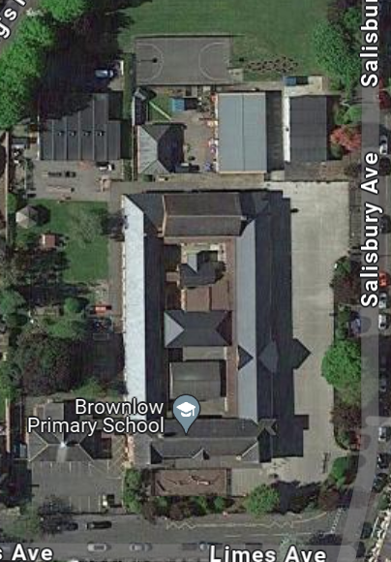
Year 1/2 information: Where is my child’s classroom?
Children can enter the school via any of the external doors and make their way to their classroom. We understand occasionally parents need to accompany their child to the classroom however we will be encouraging children to build independence and make their own way to class from the external doors.
Mr G Rhodes 1/2GR
Mrs N Wade 1/2W
Mrs H Ray 1/2R
Mr J Cockerill 2C
Mrs J Challis 1/2JC
Children will exit with their teacher at the end of the day. Lunch box trolleys will be on the slabbed area. Please avoid standing in the slabbed area at the end of the day.

Slide 12
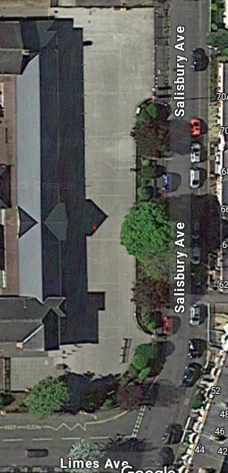
Where will I need to collect my child from at home time?
Where will the lunchbox trolleys be?
Children will exit with their teacher at the end of the day and stand in this order along the building on the playground– please collect from this area.
Mrs J Challis 1/2JC
Mr J Cockerill 2C
Mrs H Ray 1/2R
Mrs N Wade 1/2W
Mr G Rhodes 1/2GR
LUNCHBOX TROLLEYS
Year 1/2

Slide 13
Questions and Answers for Year 1 & 2
Does my child need a PE bag in Year one/Two?
No, children will arrive at school in their PE kit on their assigned PE days, these days will change over the year so please keep an eye on Class Dojo and MCAS app for changes.
Will my child have a coat peg in Year One/Two?
Yes, they will have a place to hang their coat and a place to put their bookbag.
What does my child need to bring to school every day?
The children will need a named water bottle, their book bag with Littke Wandle reading book plastic folder and a coat. If they have an Accelerated Reader book, they will not require a plastic folder unless they want to keep their old one.
Does my child need a backpack?
No, children in Year 1/2 need to use their school bookbag as space is limited.
Will my child still bring home a reading and a library book?
Yes, they will either bring home a Little Wandle Phonics reading book or an Accelerated Reader book, alongside a book for pleasure from the Library.
Our Library day is Tuesday
Will my child have Home Learning in Year One/Two?
Reading: the children will be asked to read their book a minimum of 4 times per week but ideally every day to help build fluency and understanding.
Spelling: will focus on the spelling of Year 1 and 2 common exception words, these words will be in their reading diary to share which will need learning.
Maths: Maths games or activities linked to class work including accessing NumBots (both Year 1 & 2), TTRockstars (Year 2 only Times Tables app in the Spring and Summer terms)
Topic: Use the knowledge organiser to support class learning and access the half-termly topic-based activities.

Slide 14
Questions and Answers for Year 1 & 2
Will I be able to speak to my child's teacher informally?
We understand occasionally parents need to accompany their child to the classroom however we will be encouraging children to build independence and make their own way to class from the external doors. Members of staff will be able to take messages on the external doors/at the office or alternatively please contact your child’s teacher via their ClassDojo messages to arrange a suitable time for a conversation. Class teachers will also be on the playground at the end of the school day if you needed to speak to them briefly.
Will my child still have fruit and milk?
Fruit is provided as part of a government scheme, but milk will only be available to children in receipt of free school meals or if parents sign up to pay for milk with the cool milk scheme.
Will I need to pay for dinners?
Until the end of Key Stage 1 (Year 2) ALL children can access the universal free school meals provided by the government. This is different to means tested free school meals. ALL meals will be ordered in the classroom by the teacher while we transition to our new catering supplier. The cut off for ordering each day is 9:30am. If your child is due to arrive in school after this time due to an appointment you would need to let the teacher know the day before to order a dinner for their return. If you arrive after this time and a dinner has not been pre-ordered the day before a packed lunch will be required.
How do I report my child’s absence?
The preferred method is to report absence by sending a message via the MCAS app, alternatively, you can call and leave a voicemail (01664 562315) option 1 for absences, the voicemail service is available 24hrs a day.

Slide 15
Our PE/Library Days
These will be the PE days for the first half term, then changes will be notified on both MCAS and Class Dojo
Class | PE/Library
1/2C | PE: Wednesday & Thursday LIBRARY: Tuesday
1/2R | PE: Monday & Thursday LIBRARY: Tuesday
1/2W | PE: Monday & Thursday LIBRARY: Tuesday
1/2GR | PE: Monday & Thursday LIBRARY: Tuesday
1/2JC | PE: Monday & Thursday LIBRARY: Tuesday

Slide 16
Our Curriculum overview
Topic information for each half term
Autumn 1: Fire, Fire! Why did London burn? | Autumn 2: Where would you find an Emperor Penguin?
Spring 1: How can we make the everyday extraordinary? | Spring 2: Why is Melton the rural food capital?
Summer 1: How is a hot desert different? | Summer 2: How can we use the natural world to create art?

Slide 17
Trips/Visitors
In Year 2 the children will participate in school trips. These are provisional, but we hope to be able to offer similar this coming academic year:
A visitor will lead a session linked to our Geography topic about Antarctica.
A cinema trip in the Autumn Term, as an end of term activity.
Hold a Brownlow ‘Art Exhibition’ for parents in the Spring Term 1.
History walks around Melton linked to our History topic in Spring Term 2.
A trip to the Dee Close Field to look at and create natural art in the Summer Term 2.
Nativity Assembly
In December, children will perform songs in a Christmas Assembly linked to the Nativity Story. Ticket details will be communicated to you nearer the time.

Slide 18
Assessment in Year 1 and Year 2
In June children in Year 1 will complete a phonics screen statutory assessment. Our Little Wandle systematic synthetics phonics scheme prepares children well, however, please continue to support your child at home by looking at the weekly phonics home learning sheets which are sent home. These cover the new learning that your child has completed in their phonics sessions and please also attend our parent workshops.
Any children who did not pass the statutory phonics screening in Year 1 will need to retake the screening in Year 2. This will take place in June.
Children in both years will also be assessed in the main areas of the curriculum, reading, writing, maths and science throughout the year.

Slide 19
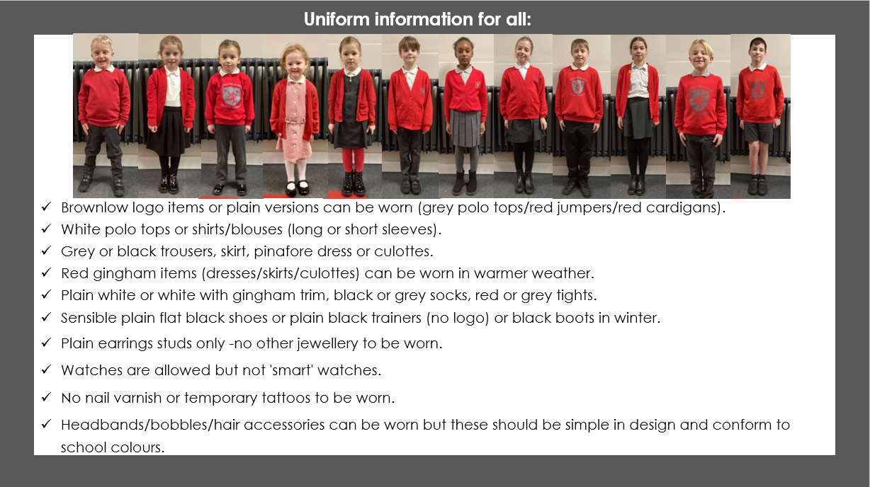
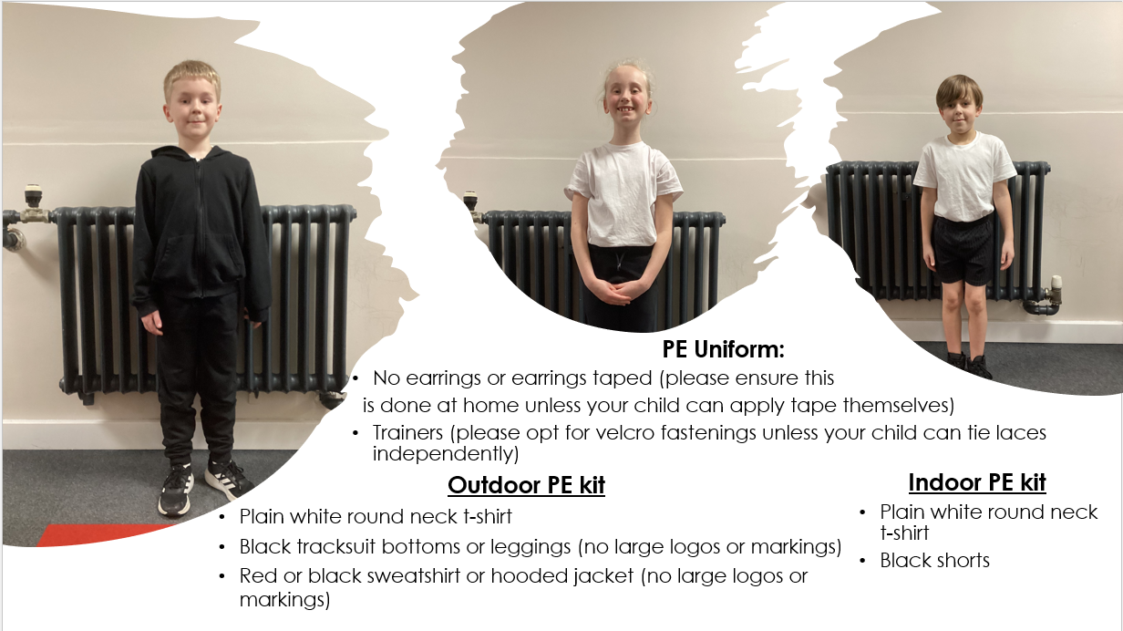
Uniform expectations

